Slide 1


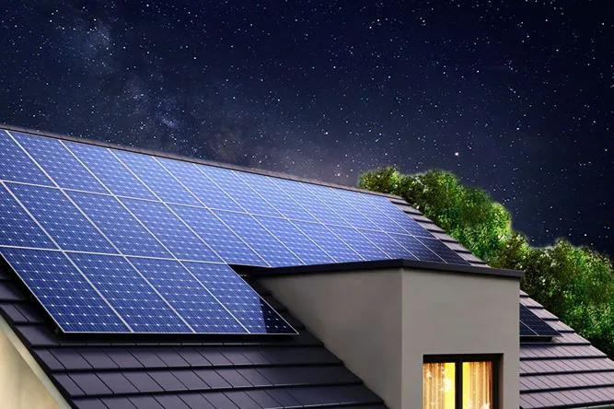
UDA Green City

Slide 2
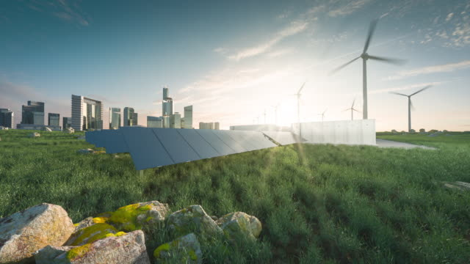

UDA Green City
Welcome to USD Green City, where sustainability meets urban living. In just three words, we encapsulate a vision of a modern, environmentally conscious, and vibrant community.
Join us as we explore the innovative, eco-friendly, and thriving environment that USD Green City represents.
02

Slide 3
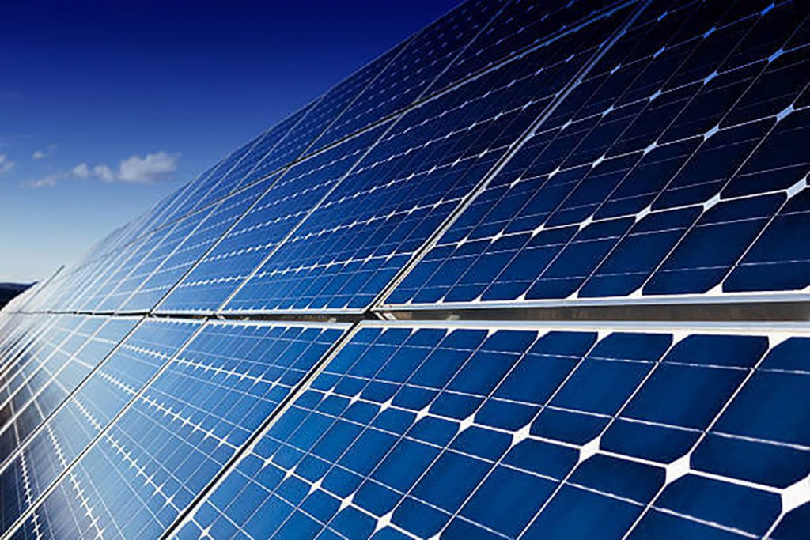
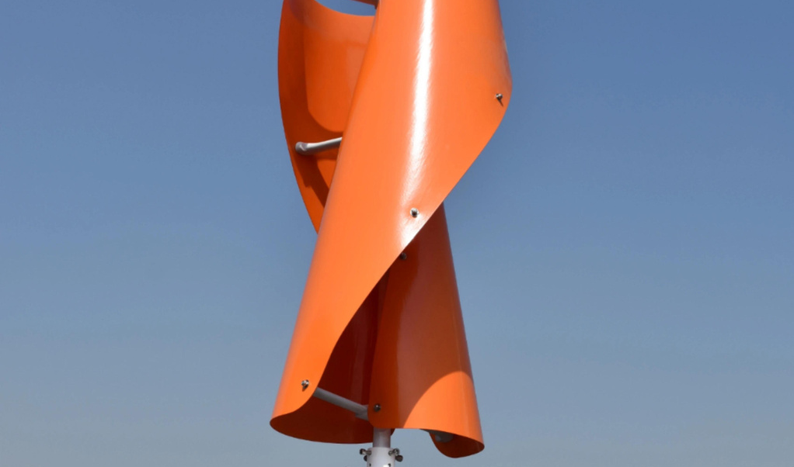
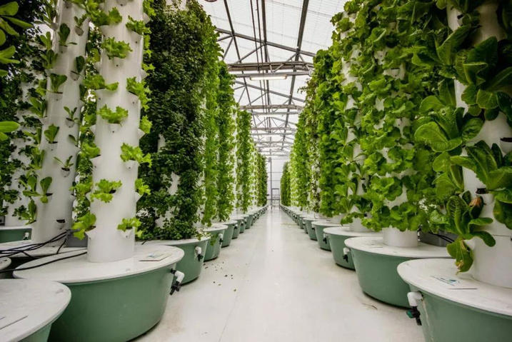
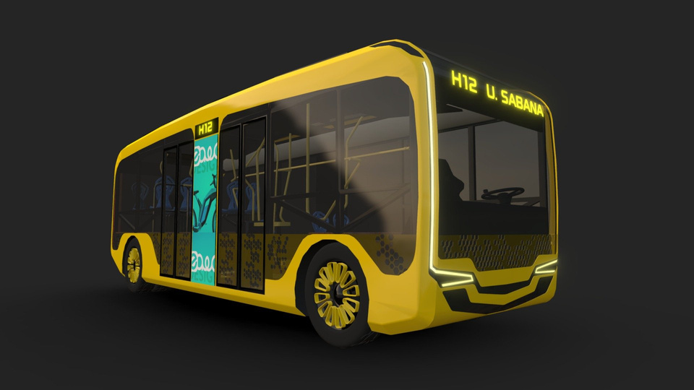
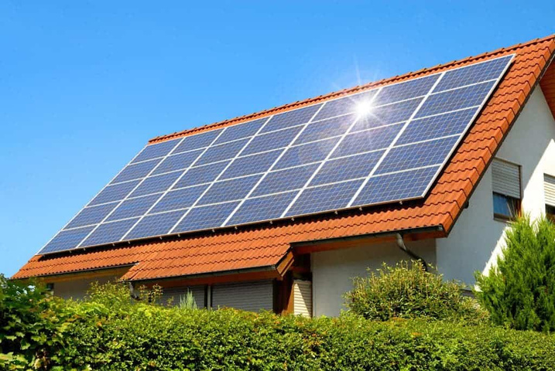
UDA Green City
03

Slide 4
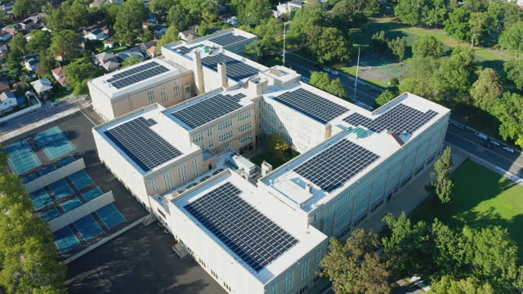
UDA Green City
The Next Generation of Cities
In a rapidly evolving world, cities are transforming into dynamic, smart, and sustainable hubs of innovation and progress. Join us as we delve into the future of urban living, where technology, sustainability, and community converge to shape the next generation of cities.
04

Slide 5
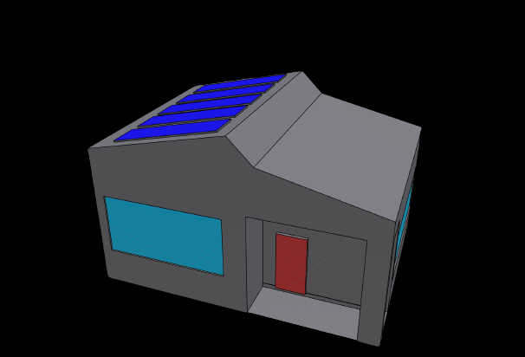
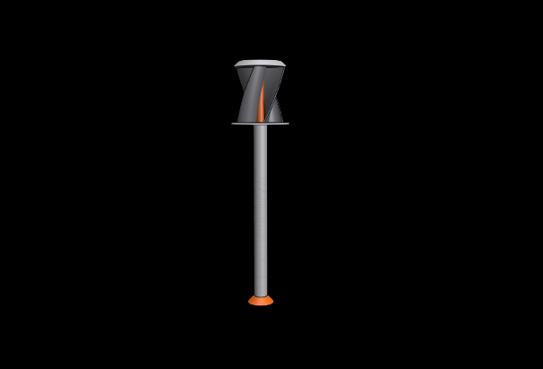
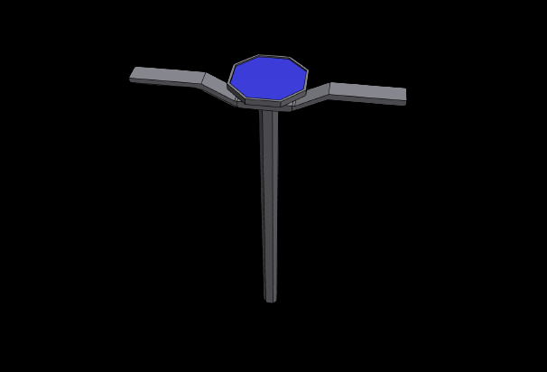
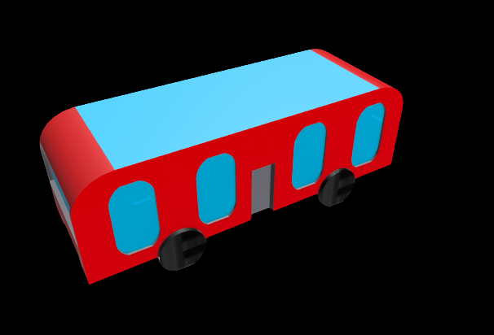
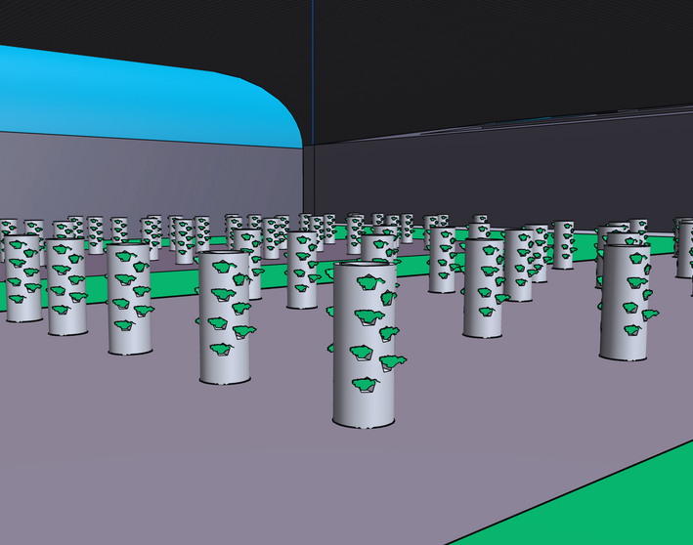
UDA Green City
05

Slide 6
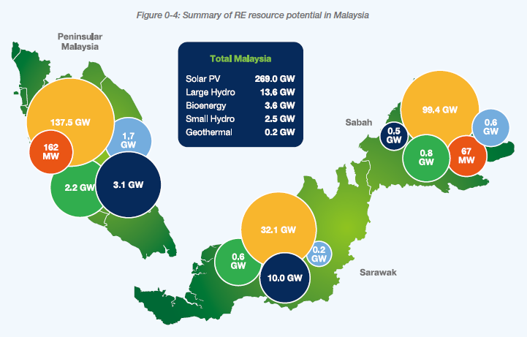
UDA Green City
Weather patterns in Malaysia
Solar Energy:
Abundant Sunshine: Malaysia enjoys consistent sunlight throughout the year, with an average of 4-5 peak sun hours per day. This makes it an excellent location for solar energy production.
Wind Energy:
the country's renewable energy programs primarily focus on solar and hydropower. However, wind energy can be useful in select regions with higher than average wind energy capacity.
06

Slide 7
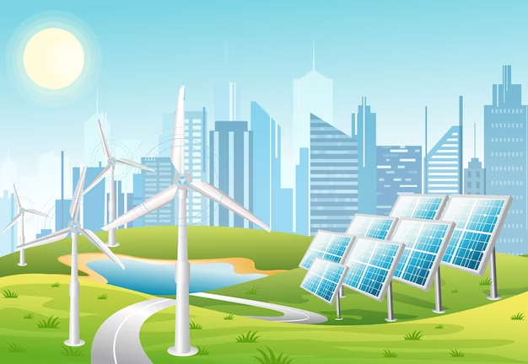
UDA Green City
Investment in Renewable Energy
Solar Panels :
Residential Solar Panels in Malaysia typically range from RM 5,000 to RM 15,000 per kilowatt (kW)
Commercial and Industrial Solar Panels for larger-scale installations often range from RM 4,000 to RM 10,000 per kW.
Wind Turbines:
Small-scale residential wind turbines (usually less than 10 kW) can cost between RM 5,000 to RM 60,000 or more for Larger wind turbines.
07

Slide 8
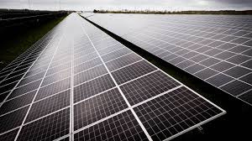
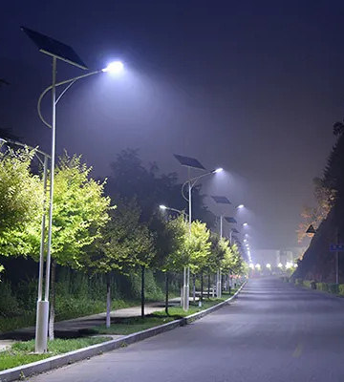


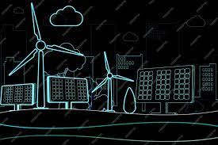
Invest for The Futere

Slide 9
UDA Green City
Profitability
Solar Panels
Residential solar panel systems often have a payback period of around 5 to 8 years in Malaysia. Commercial and industrial-scale solar typically around 3 to 6 years.
After the payback period, you can expect an annual ROI of around 10-15% or more, as your electricity savings continue.
Wind Turbines
The payback period for wind turbines varies widely based on factors such as size, location, and energy consumption. It can range from 5 to 15 years or more.
The annual ROI for wind turbines also varies but may be in the range of 5-12% after the payback period.
09

Slide 10

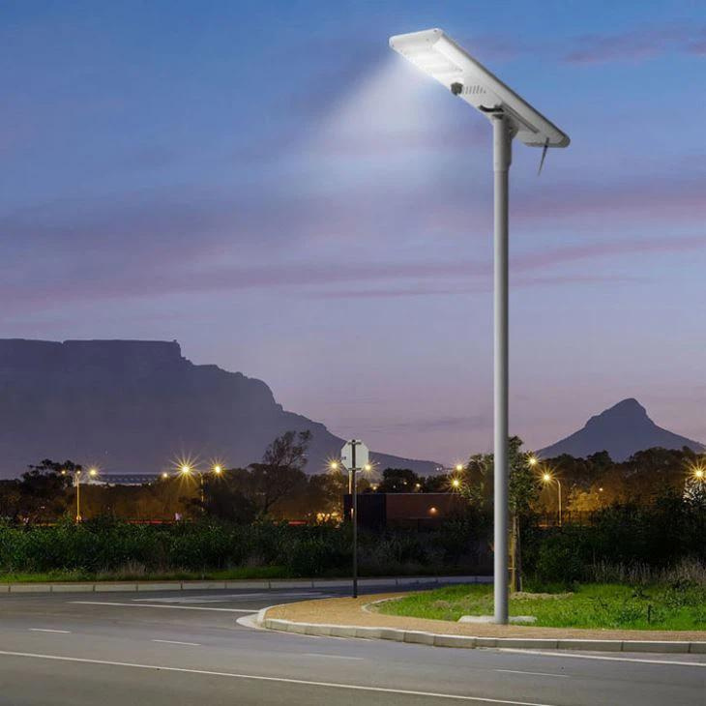
UDA Green City
Low-carbon VS High-carbon cities
Initial Investment
Developing green infrastructure and sustainable practices in a city can require significant upfront investments. This includes building green spaces, implementing renewable energy sources, improving public transportation, and enhancing waste management.
Economic Benefits
Green cities often experience lower energy costs, improved air quality, reduced traffic congestion, and increased property values.
Long-term Savings
The ROI for green cities is often realized over a more extended period, as the initial investments in sustainability pay off over time.
10

Slide 11

UDA Green City
Low-carbon VS High-carbon cities
Initial Investment
Non-green cities may have lower upfront infrastructure costs, but they often face higher long-term costs due to resource inefficiency, pollution, and increased demand for energy and transportation infrastructure.
Economic Benefits
Non-green cities may suffer from higher levels of pollution, which can lead to health problems and environmental degradation. These factors can result in increased healthcare costs and a reduced quality of life.
Long-term Savings
Non-green cities may be less resilient to climate change, natural disasters, and resource scarcity, which can lead to higher costs associated with adapting to these challenges.
11

Slide 12

UDA Green City
Solar panel Wattage
Solar Panel Capacity: A typical residential solar panel has a capacity ranging from 250 to 400 watts.
Average Home Energy Consumption: On average, a typical U.S. home consumes around 10,000 to 12,000 kilowatt-hours (kWh) of electricity annually.
For example, if you have a 300-watt solar panel:
300 watts / 10,000 kWh = 0.03 homes
This suggests that one 300-watt solar panel can provide about 3% of the annual electricity needs for one home.
12

Slide 13
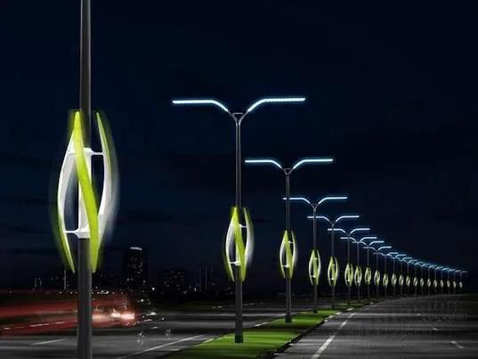
UDA Green City
Wind Turbines Wattage
Small residential wind turbines typically range from 1 kW to 10 kW, while larger commercial or utility-scale turbines can range from 1 MW to 5 MW or more.
Average Home Energy Consumption in the United States: The average U.S. household consumes about 10,000 to 12,000 kilowatt-hours (kWh) of electricity annually.
Example Calculation (United States): Let's use a common capacity for a larger wind turbine of 2 MW (2,000 kW) for this example:
2,000 kW (2 MW) / 12,000 kWh per home = Approximately 167 homes.
This means that a 2 MW wind turbine, in ideal wind conditions, could potentially provide enough electricity to power approximately 167 homes in the United States,
13

Slide 14
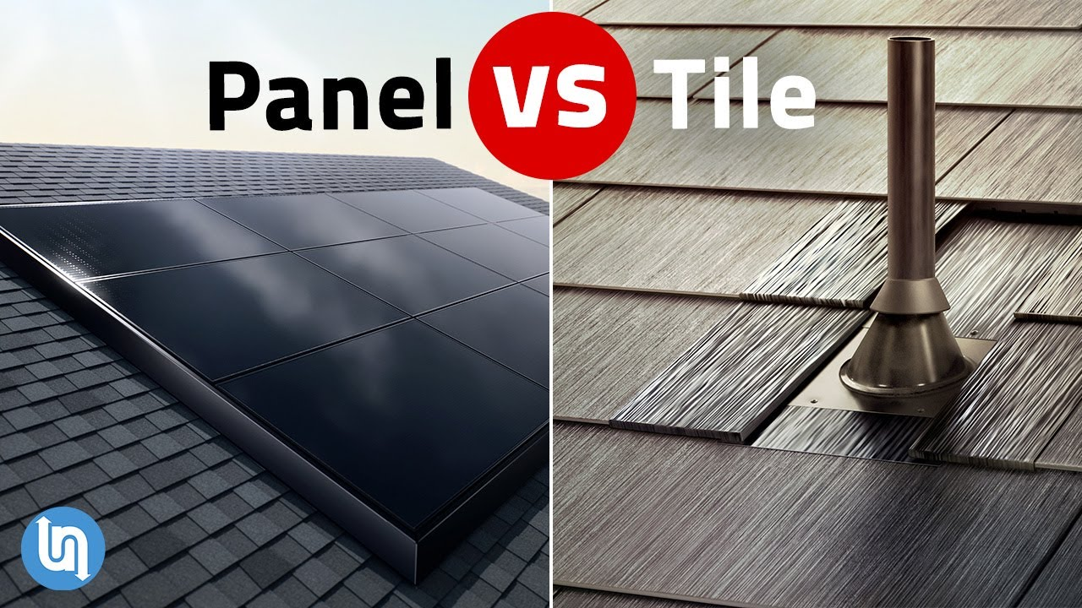
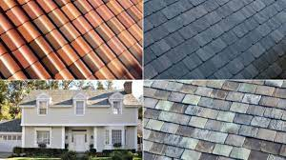
UDA Green City
Next-Generation Technology
TESLA
The Tesla Solar Roof is an innovative solar energy solution that replaces traditional roofing materials with solar panels. It seamlessly blends aesthetics and sustainability, harnessing sunlight to generate electricity for a home while enhancing its curb appeal. Although the product has garnered interest, its widespread adoption is still evolving, driven by advancements in solar technology and affordability.
You can what this video for more information
https://youtu.be/UJeSWbR6W04?si=KmiZCEFqZicJXItA
14

Slide 15
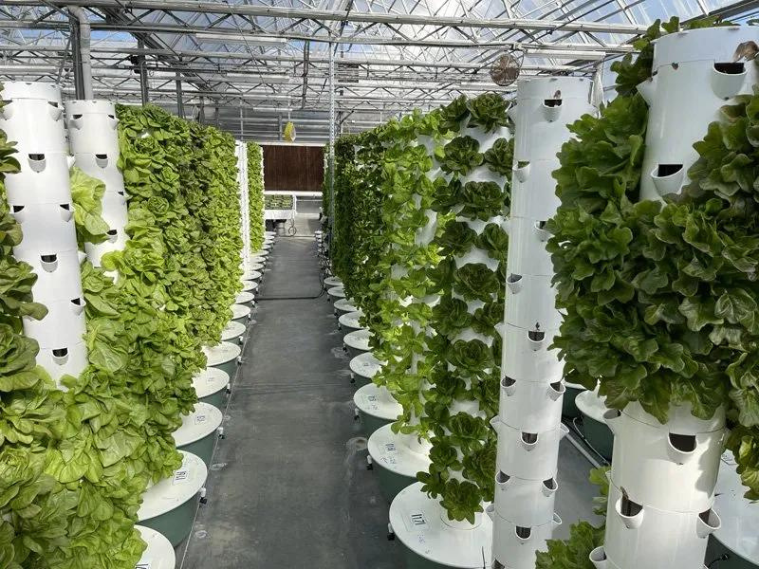
UDA Green City
Vertical Farming
An aeroponic tower is a vertical farming system that doesn't use soil. Instead, it nourishes plants by spraying their roots with a nutrient-rich mist. This method is water-efficient and allows plants to grow faster. It's an excellent choice for urban and indoor gardening, making the most of limited space.
You can what this video for more information
https://youtu.be/b874duO4IPM?si=eTJXqz3SSqZ_HhC0
15

Slide 16

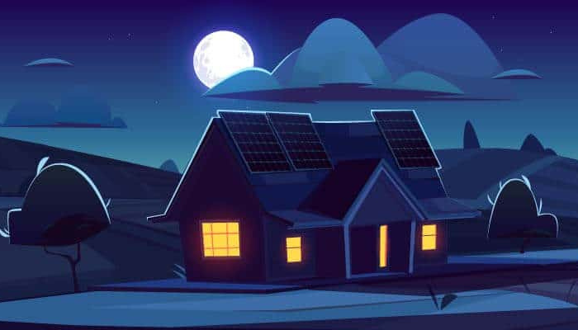
Thank you!

